Slide 1
Binding Methods

Slide 2
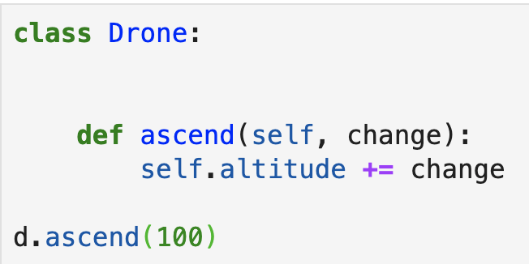
How a Method Is Called
Notes:
Let’s take a closer look at what happens when we call a method of an instance.
start with d.ascend.This is what we call a bound method.it’s a function that is associated with a specific instance.
In python, the binding of a method to an instance is quite transparent.
Python takes the object d, and maps it to the first parameter of the method.so inside the method, self will resolve to d.
We can also pass in an argument - in this case, the int 100.
The arguments get mapped to all the other function parameters after the first one.
So the parameter change will point to 100 inside the method.
And then the code inside the method is ready to run.

Slide 3
Binding Methods

